Slide 1
Information Retrieval
Assignment 1: Indexing
Presented by: Abdullah Nasir [2021-CS-113]
Instructor: Dr. Khaldoon Syed Khurshid
Department of Computer Science University of Engineering and Technology Lahore

Slide 2

Agenda
1.
Introduction
2.
Goal Definition
3.
Document Collection
4.
Implementation Plan
5.
Approaches
6.
Backend
7.
User Interface
8.
Shortcomings
9.
Data Flow Diagrams

Slide 3

Introduction
Organizes data for fast and easy retrieval of specific information.
For text files, involves reading documents word by word.
Records terms found, their frequency, and positions within documents.
Enables rapid search and retrieval by locating words directly in the index.
Prevents scanning entire files for a query, optimizing performance.
Prevents scanning entire files for a query, optimizing performance.

Slide 4

Goal Definition
Develop a robust indexing system for document retrieval by both name and content.
Create indexes to streamline information retrieval from multiple text files.
Enable quick, keyword-based searches within content and file identification by name.
Designed to improve search accuracy and speed, facilitating easy access to specific data in large document collections.

Slide 5

Document Collection
Science
AI
Plants
Animal
Computer
Pokemon

Slide 6
Approaches
Previous
Current
Created an index entry for every word each time it appeared in the text.
Goal was to include all possible keywords, focusing on maximum data capture.
Quickly found this approach generated excessive and redundant indexed data.
Resulted in large, mostly irrelevant data, making search and retrieval inefficient.
Refined the method by introducing a list of stop words.
Developed lists for verb and noun suffixes to filter out less relevant words.
Improved relevance by excluding common, less meaningful words from the index.
Though more efficient, this approach still did not fully target the most critical keywords.

Slide 7
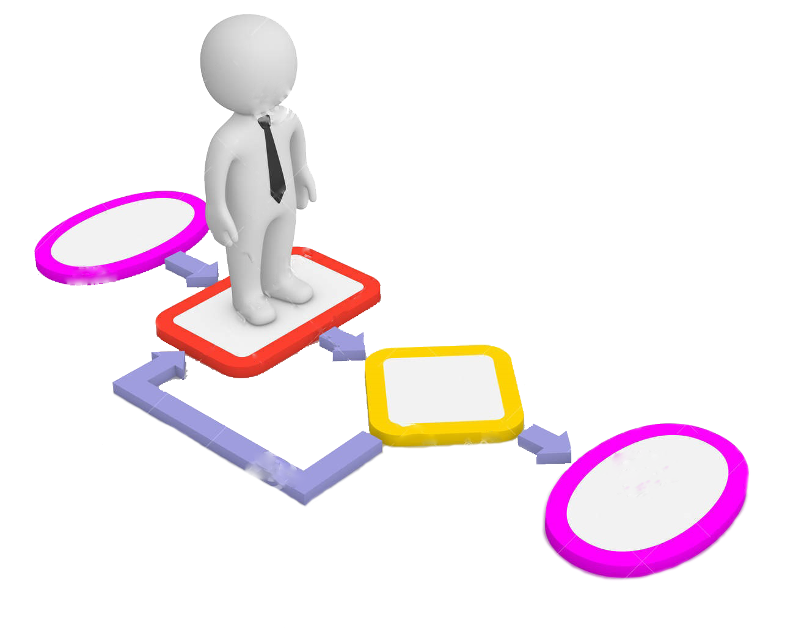
Backend
Creation and Refreshing of Index
Search by Document Name
Query by Document Content

Slide 8
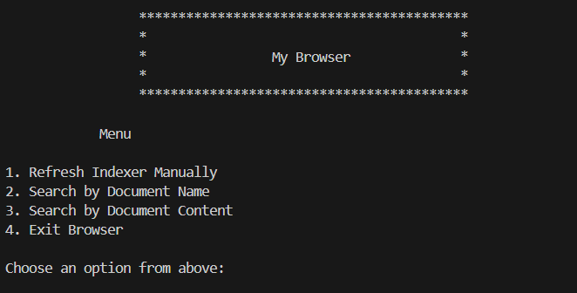
User Interface

Slide 9

Shortcoming
Does not refresh automatically.
Multi-threading may be needed in the future.
If using a file for stop words, we may need to add many words.
For the prefixes and suffixes, many terms will be added to files.
Removal of suffix is not much or too much
A limited number of punctuation is being removed right now.
No handling for typing errors for the user.

Slide 10
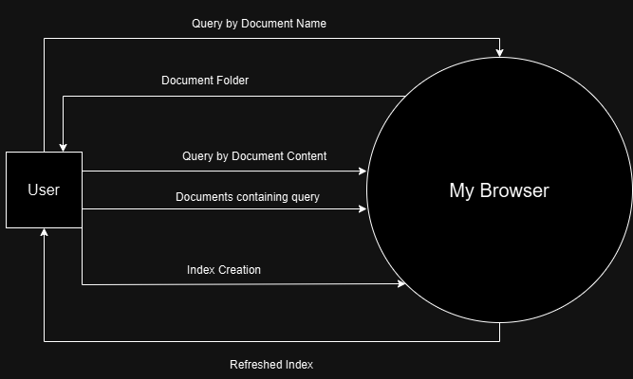
Data Flow Diagrams
DFD level 0

Slide 11
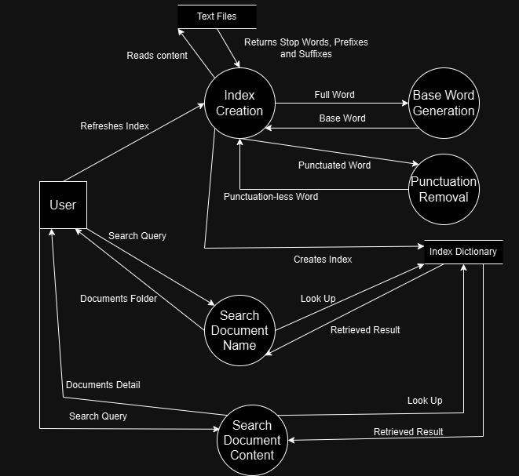
Data Flow Diagrams (cont.)
DFD level 1

Slide 12
Thank You
Suggestions and Questions are welcomed!

